Slide 1
Introduction to Sampling based inference and MCMC
Ata Kaban
School of Computer Science
The University of Birmingham

Slide 2
The problem
Up till now we were trying to solve search problems (search for optima of functions, search for NN structures, search for solution to various problems)
Today we try to:-
  Compute volumes
    Averages, expectations, integrals
  Simulate a sample from a distribution of given shape
Some analogies with EA in that we work with ‘samples’ or ‘populations’

Slide 3
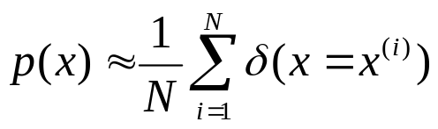
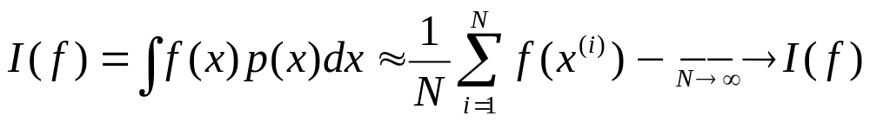
The Monte Carlo principle
p(x): a target density defined over a high-dimensional space (e.g. the space of all possible configurations of a system under study)
The idea of Monte Carlo techniques is to draw a set of (iid) samples {x₁,…,x_{N}} from p in order to approximate p with the empirical distribution
Using these samples we can approximate integrals I(f) (or v large sums) with tractable sums that converge (as the number of samples grows) to I(f)

Slide 4

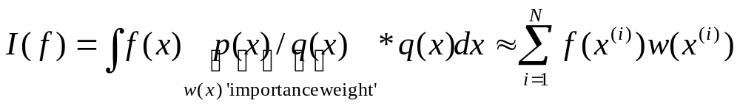
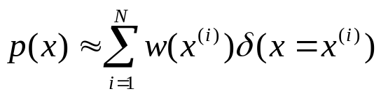
Importance sampling
Target density p(x) known up to a constant
Task: compute
Idea:
Introduce an arbitrary proposal density that includes the support of p. Then:
  Sample from q instead of p
  Weight the samples according to their ‘importance’
It also implies that p(x) is approximated by
Efficiency depends on a ‘good’ choice of q.

Slide 5
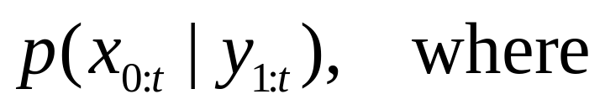
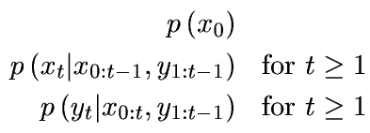
Sequential Monte Carlo
Sequential:
  Real time processing
  Dealing with non-stationarity
  Not having to store the data
Goal: estimate the distrib of ‘hidden’ trajectories
  We observe y_{t} at each time t
  We have a model:
    Initial distribution:
    Dynamic model:
    Measurement model:

Slide 6
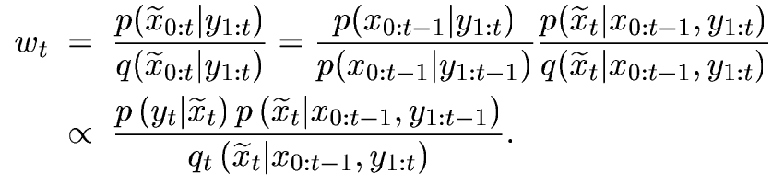

Can define a proposal distribution:
Then the importance weights are:
Obs. Simplifying choice for proposal distribution:
Then:
‘fitness’

Slide 7
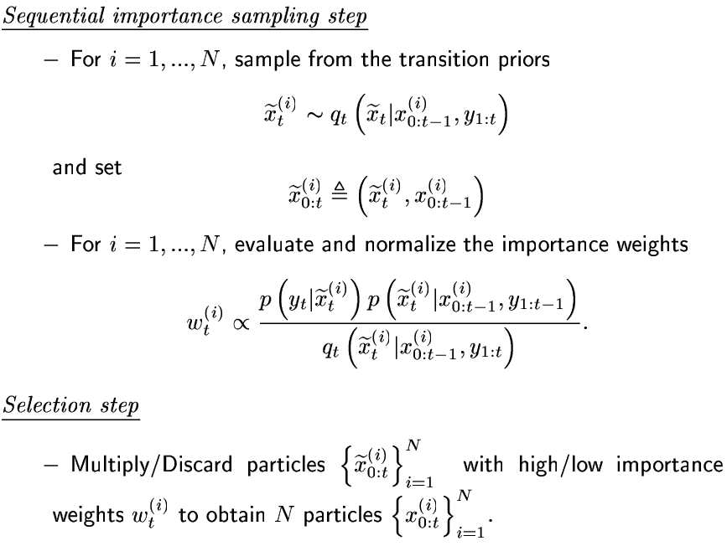

Slide 8

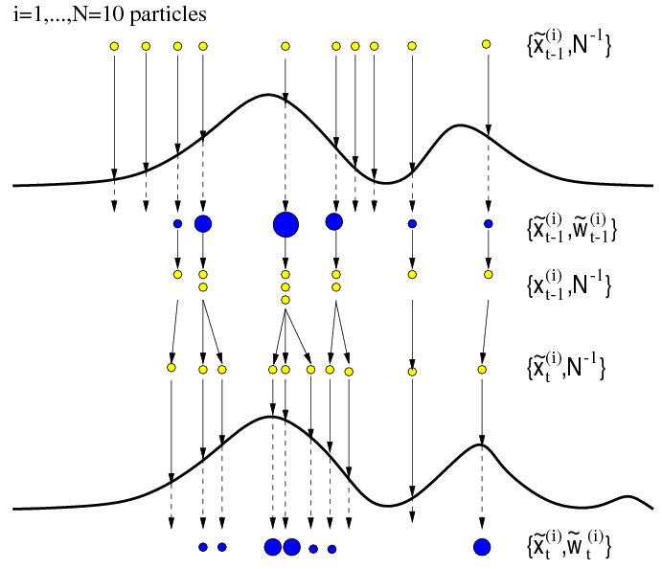

‘proposed’
‘weighted’
‘re-sampled’
---------
‘proposed’
‘weighted’

Slide 9
Applications
Computer vision
  Object tracking demo [Blake&Isard]
Speech & audio enhancement
Web statistics estimation
Regression & classification
  Global maximization of MLPs [Freitas et al]
Bayesian networks
  Details in Gilks et al book (in the School library)
Genetics & molecular biology
Robotics, etc.

Slide 10
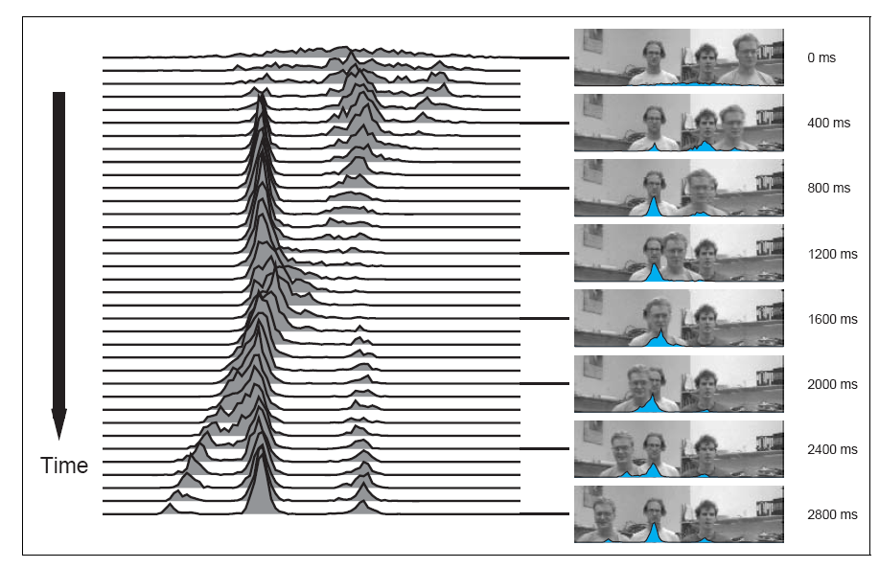
M Isard & A Blake: CONDENSATION – conditional density propagation for visual tracking. J of Computer Vision, 1998

Slide 11
References & resources
[1] M Isard & A Blake: CONDENSATION – conditional density propagation for visual tracking. J of Computer Vision, 1998
Associated demos & further papers: http://www.robots.ox.ac.uk/~misard/condensation.html
[2] C Andrieu, N de Freitas, A Doucet, M Jordan: An Introduction to MCMC for machine learning. Machine Learning, vol. 50, pp. 5--43, Jan. - Feb. 2003.
Nando de Freitas’ MCMC papers & sw
http://www.cs.ubc.ca/~nando/software.html
[3] MCMC preprint service http://www.statslab.cam.ac.uk/~mcmc/pages/links.html
[4] W.R. Gilks, S. Richardson & D.J. Spiegelhalter: Markov Chain Monte Carlo in Practice. Chapman & Hall, 1996

Slide 12
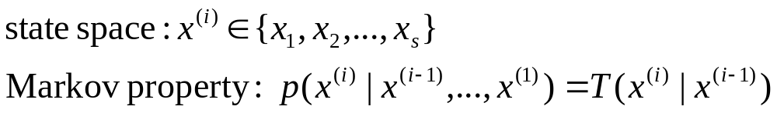
The Markov Chain Monte Carlo (MCMC) idea
Design a Markov Chain on finite state space
…such that when simulating a trajectory of states from it, it will explore the state space spending more time in the most important regions (i.e. where p(x) is large)

Slide 13
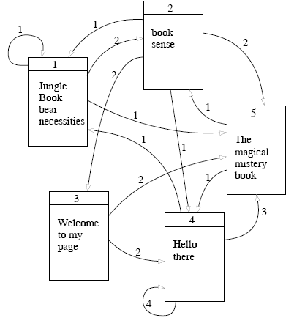
Stationary distribution of a MC
Supposing you browse this for infinitely long time, what is the probability to be at page x_{i}.
No matter where you started off.
=>PageRank (Google)

Slide 14

Google vs. MCMC
Google is given T and finds p(x)
MCMC is given p(x) and finds T
  But it also needs a ‘proposal (transition) probability distribution’ to be specified.
Q: Do all MCs have a stationary distribution?
A: No.

Slide 15
Conditions for existence of a unique stationary distribution
Irreducibility
  The transition graph is connected (any state can be reached)
Aperiodicity
  State trajectories drawn from the transition don’t get trapped into cycles
MCMC samplers are irreducible and aperiodic MCs that converge to the target distribution
These 2 conditions are not easy to impose directly

Slide 16
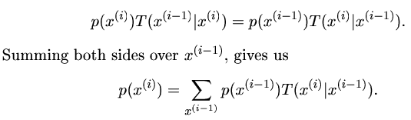
Reversibility
Reversibility (also called ‘detailed balance’) is a sufficient (but not necessary) condition for p(x) to be the stationary distribution.
It is easier to work with this condition.

Slide 17
MCMC algorithms
Metropolis-Hastings algorithm
Metropolis algorithm
  Mixtures and blocks
Gibbs sampling
other
Sequential Monte Carlo & Particle Filters

Slide 18
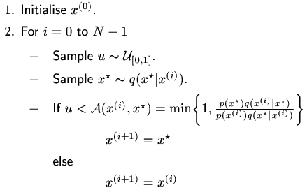
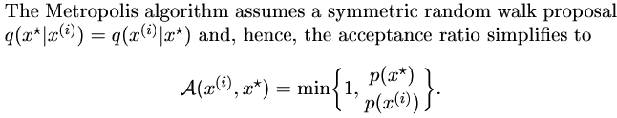
The Metropolis-Hastings and the Metropolis algorithm as a special case
Obs. The target distrib p(x) in only needed up to normalisation.

Slide 19
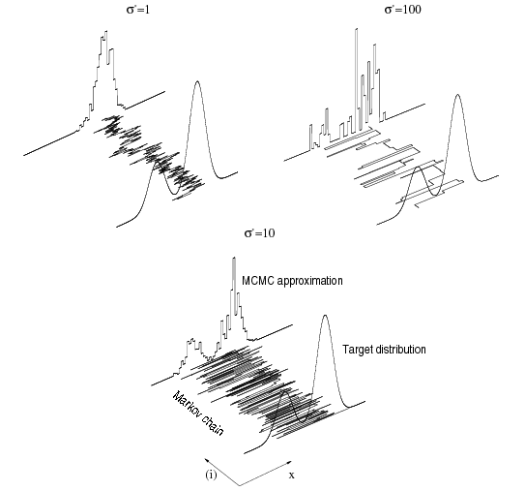
Examples of M-H simulations with q a Gaussian with variance sigma

Slide 20
Variations on M-H:
Using mixtures and blocks
Mixtures (eg. of global & local distributions)
  MC1 with T1 and having p(x) as stationary p
  MC2 with T2 also having p(x) as stationary p
  New MCs can be obtained: T1*T2, or
  a*T1 + (1-a)*T2, which also have p(x)
Blocks
  Split the multivariate state vector into blocks or components, that can be updated separately
  Tradeoff: small blocks – slow exploration of target p
  large blocks – low accept rate

Slide 21


Gibbs sampling
Component-wise proposal q:
  Where the notation means:
Homework: Show that in this case, the acceptance probability is =1
[see [2], pp.21]

Slide 22
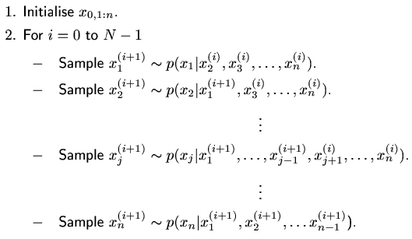
Gibbs sampling algorithm

Slide 23
More advanced sampling techniques
Auxiliary variable samplers
  Hybrid Monte Carlo
    Uses the gradient of p
  Tries to avoid ‘random walk’ behavior, i.e. to speed up convergence
Reversible jump MCMC
  For comparing models of different dimensionalities (in ‘model selection’ problems)
Adaptive MCMC
  Trying to automate the choice of q

